Slide 1
WATER MONITORING SYSTEM
JAHNAVI P
ARINDAM CHOWDHURY
JAMMULA NIKHIL
KURAGANTI SAI SUMA SHREE

Slide 2
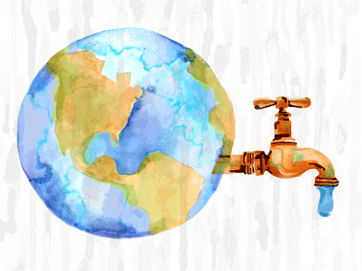
WATER CRISIS WILL BE A REALITY BY 2025 IF NEGLECTED

Slide 3
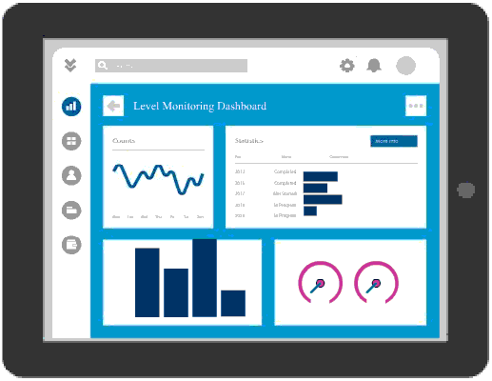
CLOUD WATCH EVENTS
ARDUINO
VANILLA
LAMBDA
API GATEWAY
DYNAMODB
GPRS
NRF
BOOTSTRAP
UNO
AJAX
JQUERY

Slide 4



IOT Recordings
LAMBDA
TABLES
(RDS
or DYNAMODB)
API GATEWAY
Webpage Interaction

Slide 5
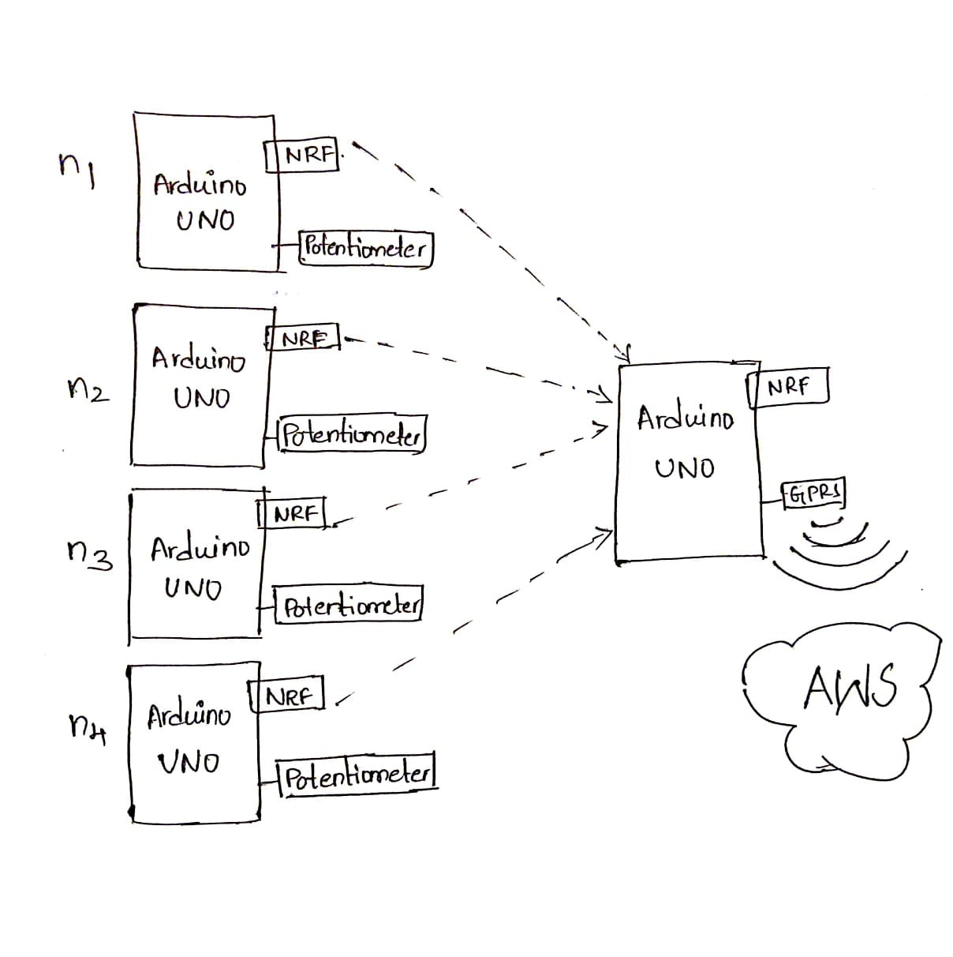

Slide 6
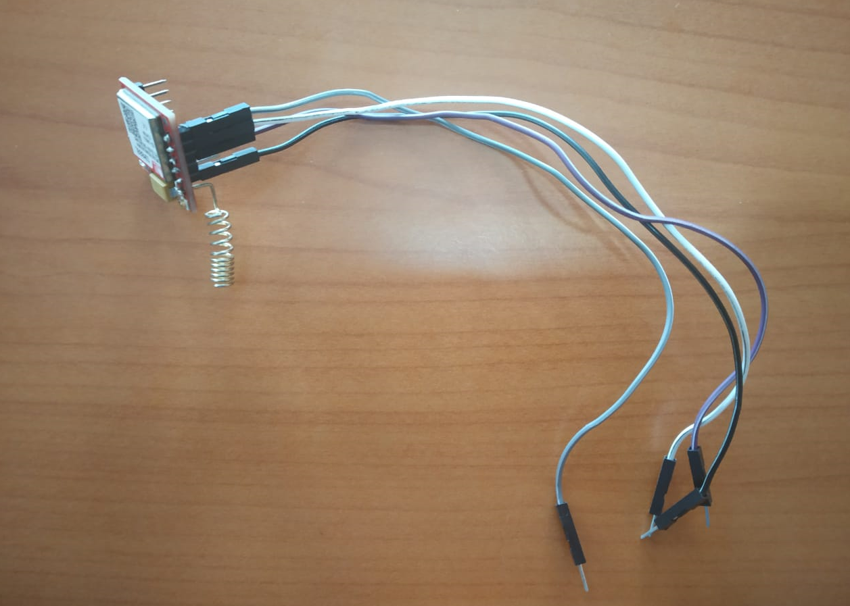
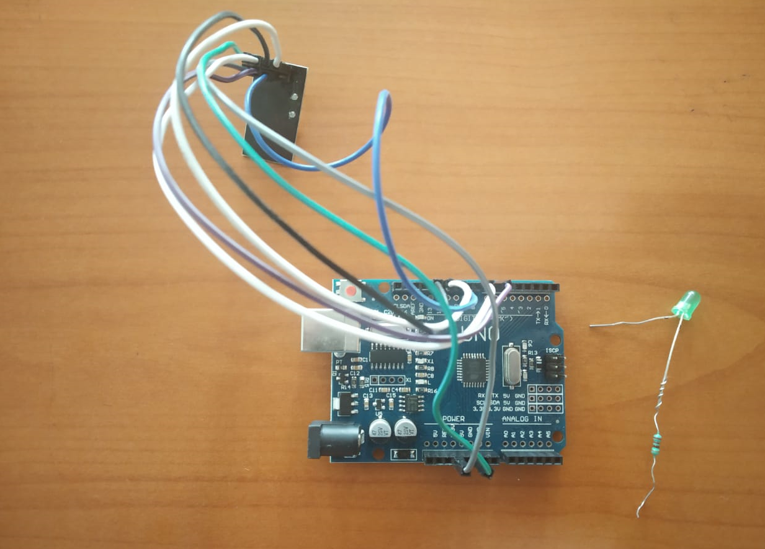
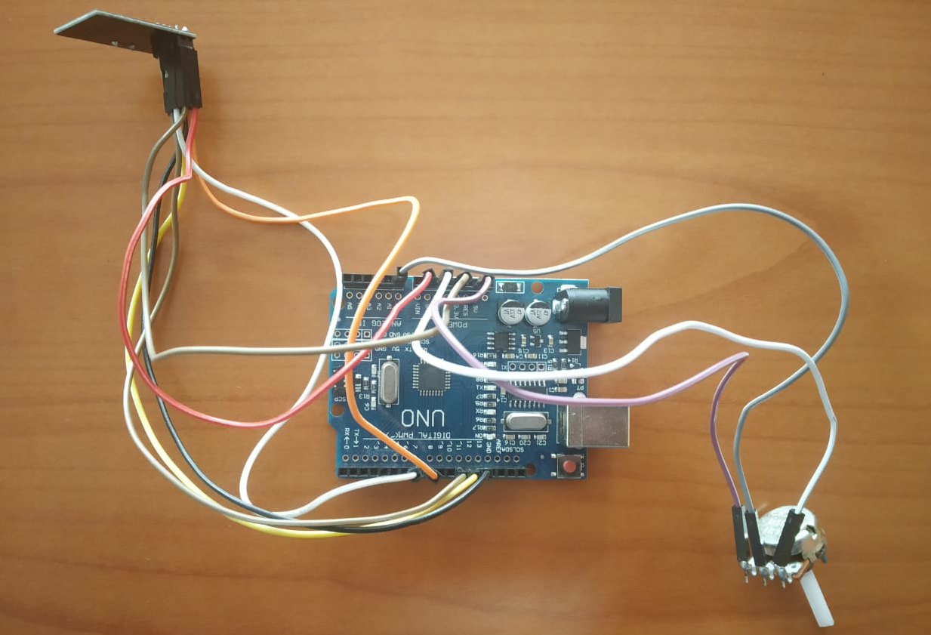

Slide 7




Slide 8
FRONT-END

Slide 9
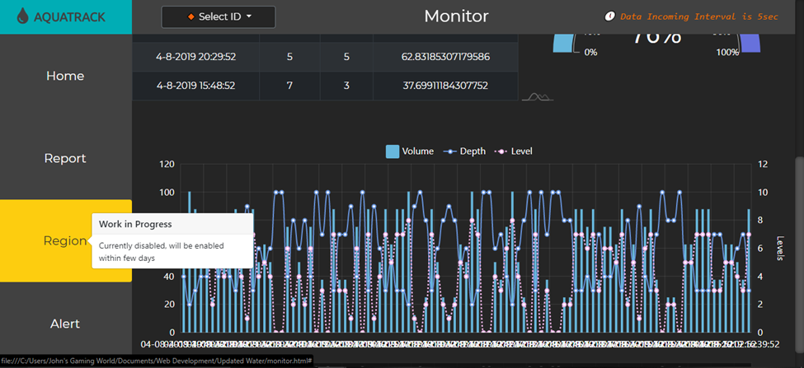
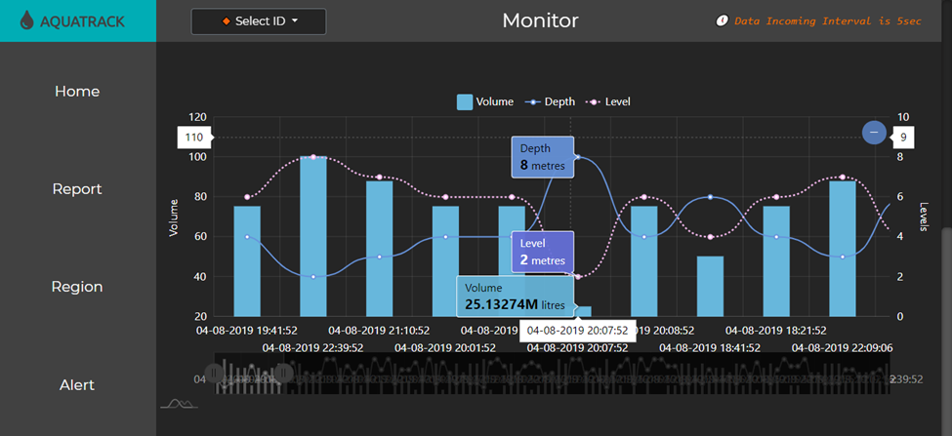
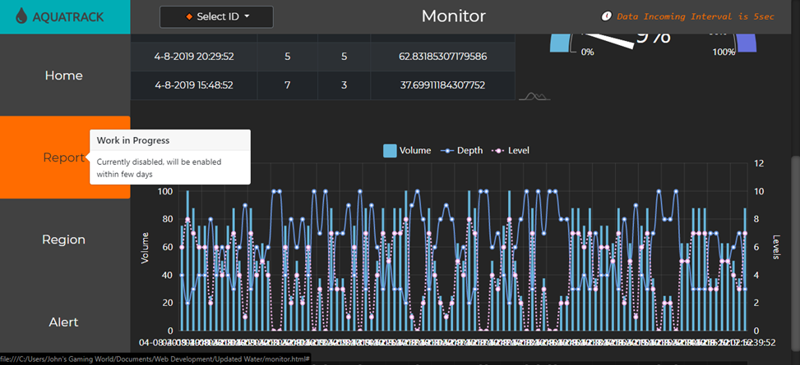
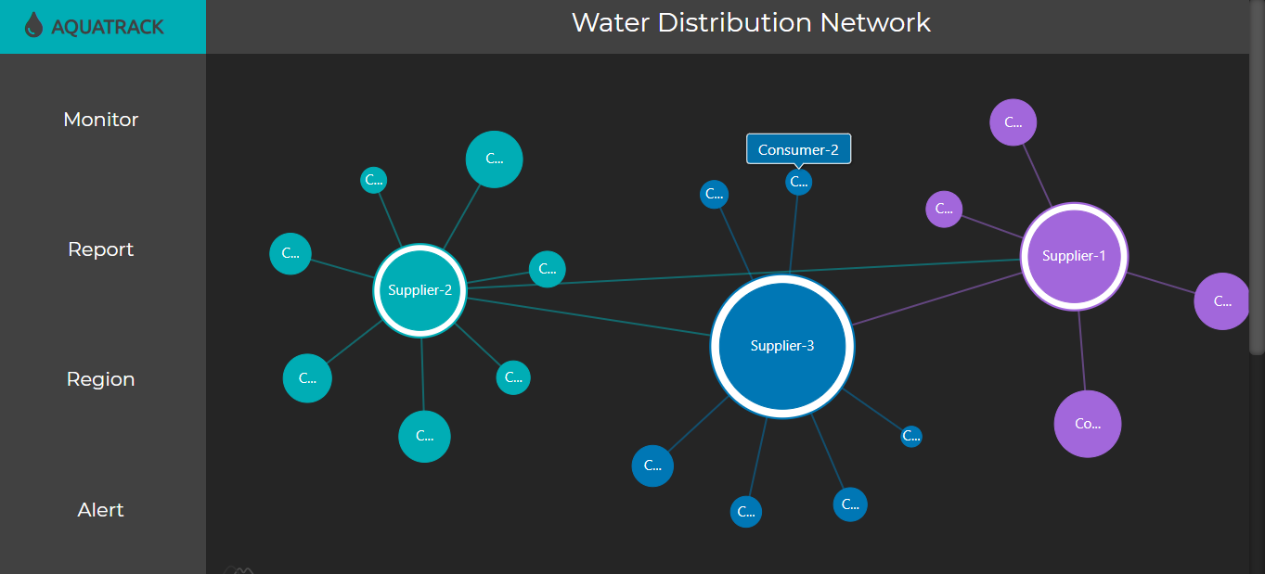
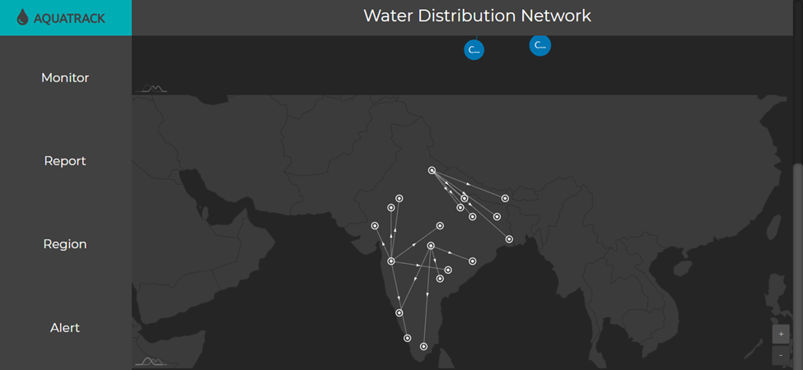
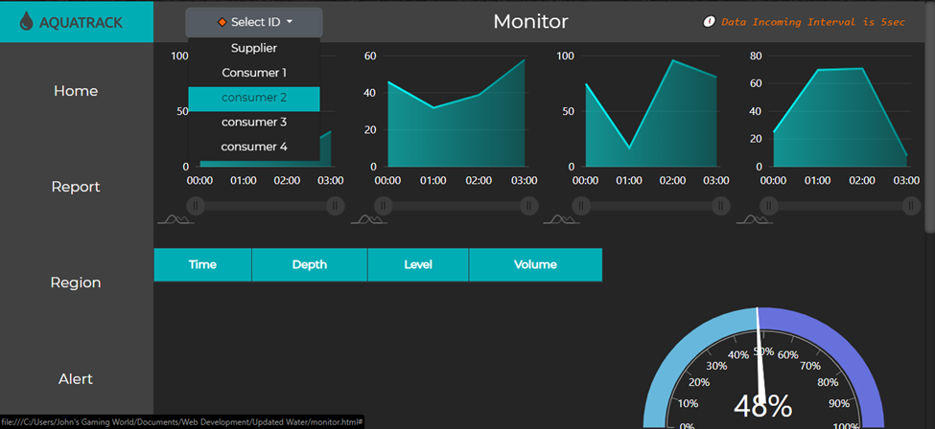
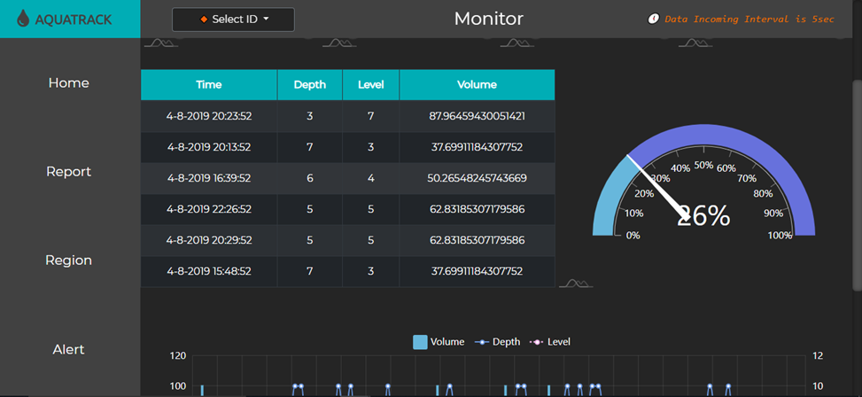
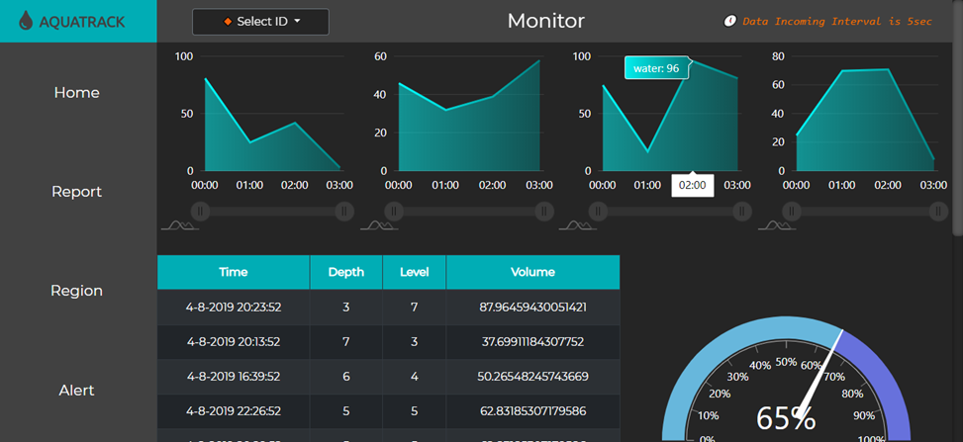

Slide 10
DEMO TIME

